Slide 1


Slide 2
Decision Tree
Decision Trees are versatile Machine Learning algorithms that can perform both classification and regression tasks.
Let us see how does it look like

Slide 3
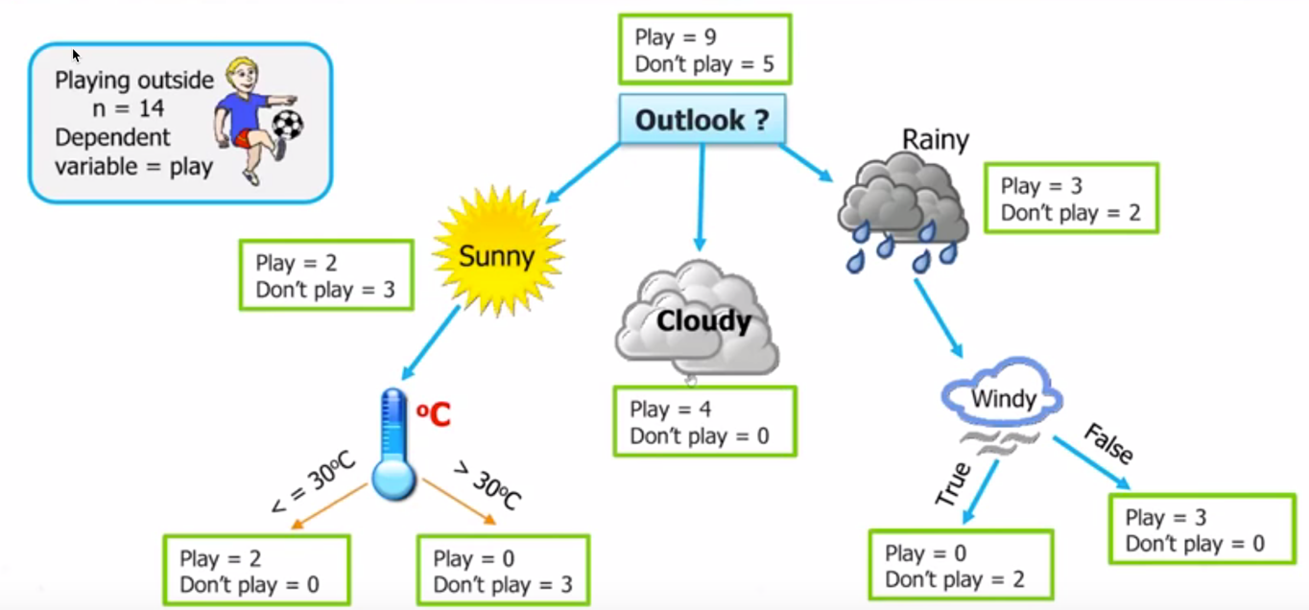

Slide 4
Traits
White box models: Decision Trees are fairly intuitive and their decisions are easy to interpret
Require very little data preparation. Don’t require feature scaling at all.
Make very few assumptions about the training data (as opposed to linear models, which obviously assume that the data is linear, for example). If left unconstrained, it will most likely over fit

Slide 5
Tree Hyperparameters
Total number of nodes
Total depth
Minimum number of items nodes must have to split
Minimum number of items leaf must have
Max leaf nodes

Slide 6
Dataset can have multiple trees how to decide which one to pick

Slide 7
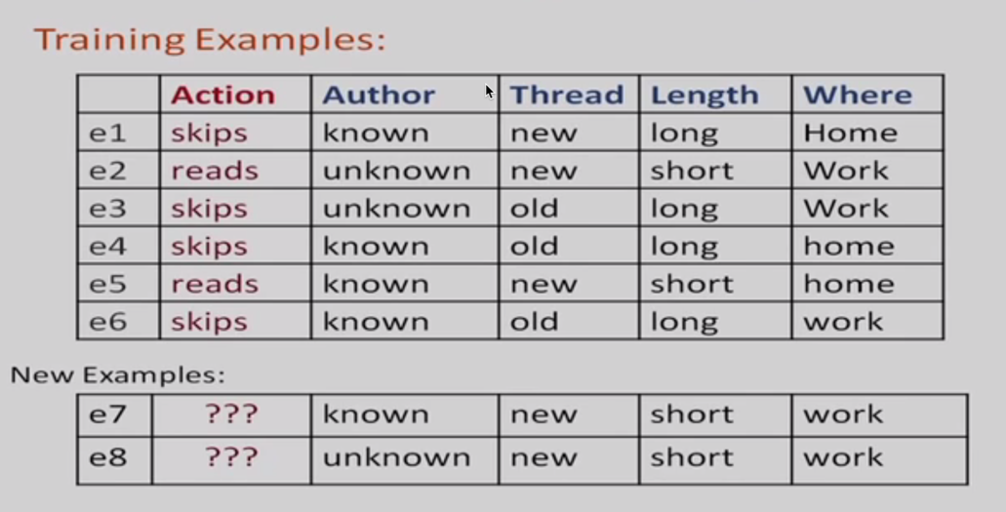

Slide 8
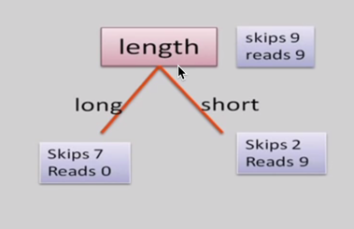
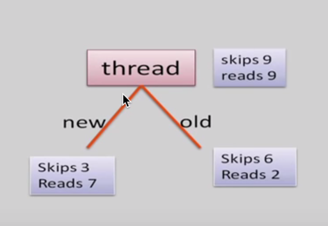

Slide 9
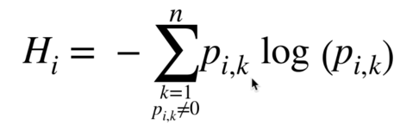

Gini Impurity or Entropy, Gain

Slide 10
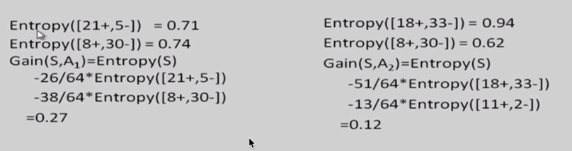

Slide 11
Ensemble Learning
Let do you decide which movie to watch?

Slide 12
Ensemble Learning
Aggregate the predictions of a group of predictors (such as classifiers or regressors), you will often get better predictions than with the best individual predictor. A group of predictors is called an ensemble

Slide 13
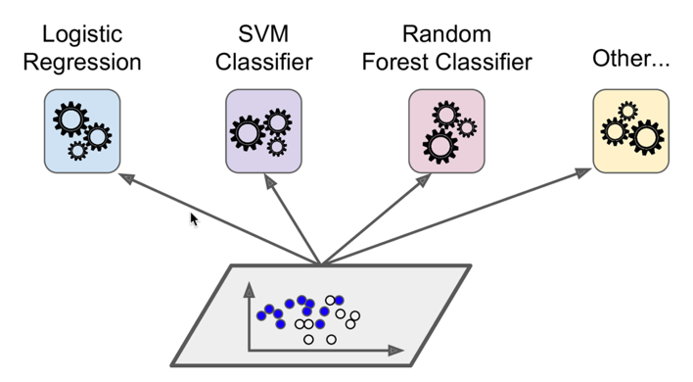

Slide 14
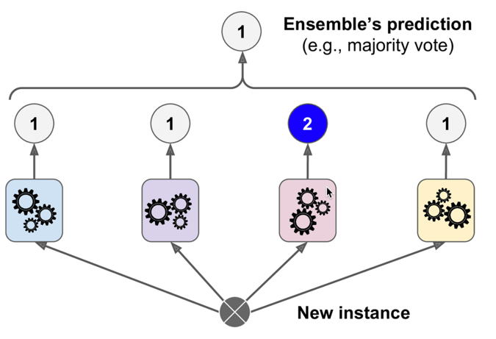

Slide 15
Voting
Hard – Majority vote
Soft - Average

Slide 16
Strong (Weak predictor)s
Ensemble methods work best when the predictors are as independent from one another as possible. One way to get diverse classifiers is to train them using very different algorithms. This increases the chance that they will make very different types of errors, improving the ensemble’s accuracy.

Slide 17
Types
Bagging
Boosting
Stack

Slide 18
Bagging
use the same training algorithm for every predictor, but to train them on different random subsets of the training set

Slide 19
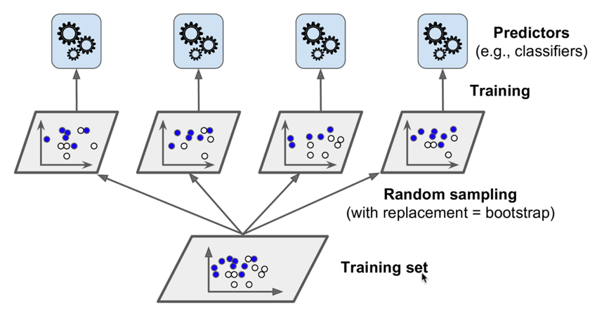

Slide 20
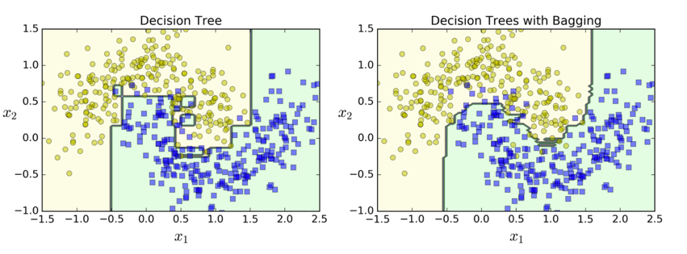

Slide 21

Random forest

Slide 22
Random forest
Ensemble of Decision Trees
max_samples set to the size of the training set
searches for the best feature among a random subset of features - results in better diversity
Can compute in parallel on multiple CPUs or distributed servers
feature importance

Slide 23
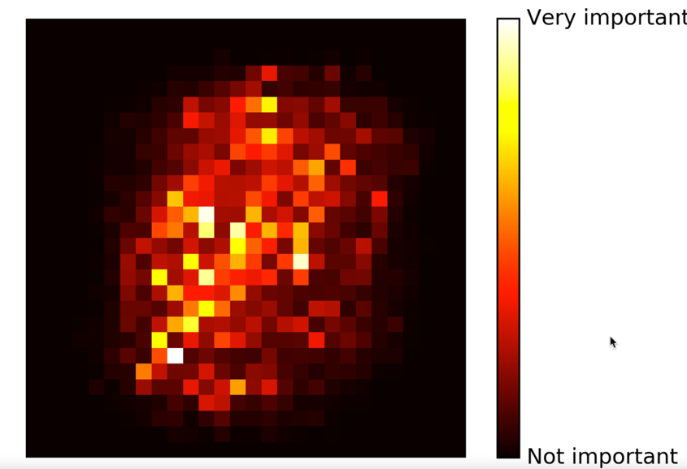

Slide 24
Boosting
train predictors sequentially, each trying to correct its predecessor

Slide 25
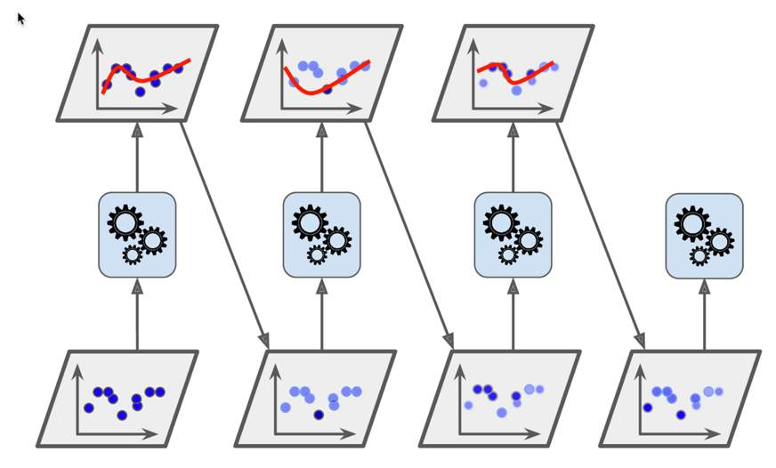

Slide 26
Stacking
Ensemble over ensemble
why don’t we train a model to perform this aggregation

Slide 27
Instead of using trivial functions (such as hard voting) to aggregate the predictions of all predictors in an ensemble

Slide 28
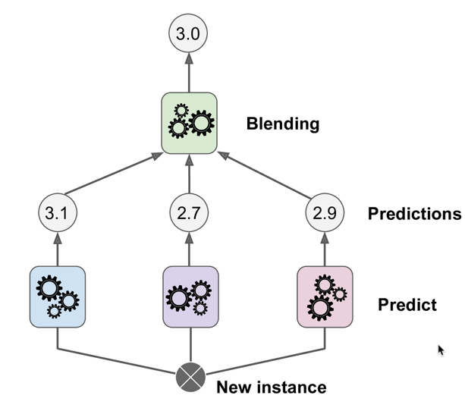

Slide 29
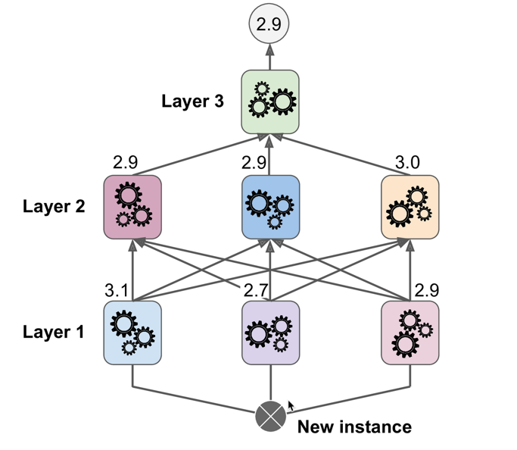

Slide 30
Practice time

